Slide 1

Group 18
BenKun Chen, Kevin Teodocio Naval, Matthew Pusch, Mehnaz Tarannum , Xi Wang

Slide 2
Introduction to
A predictable state container for JavaScript Apps
Predictable
Helps you write Apps that behave consistently.
It can run in different environments.
Centralized
Centralizing the app state makes it easier to implement data persistence.
Debuggable
The Redux DevTools make it easy to trace any state changes using “time-travel debugging”.
Flexible
Redux works with any UI layer
Commonly used with React, but also compatible with other libraries and frameworks such as Preact, Inferno, Angular, Javascript
Notes:
Redux is a state container for Javascript Apps. It is a lightweight javascript library that helps you write application in such a way that you can be sure that your app will behave consistently every time. It can be integrated in different environments such as client side, server side or even native apps.
Another feature that makes Redux so useful is Centralization of the application states which helps in logging changes to data and persisting data changes between page refreshes.
Redux also makes the application super debugggle by utilizing a tool called Redux devtool. Redux devtools makes it easy to trace changes using time travel debugging which is incredibly helpful and saves you time and effort by avoiding console.log’s everywhere.
Redux is also very flexible, works with any UI layer. Although it is most commonly used with REACT , but is also compatible with other react like libraries and frameworks like Preact, Inferno, Angular or even plain old Javascript.
We will explore all this feature in details later in this presentation
and showing the state’s changes over time, real-time changes, actions, and the current state.
Reset: resets to the state your store was created with
Revert: goes back to the last committed state
Sweep: removes all disabled actions that you might have fired by mistake
Commit: makes the current state the initial state
and has a large ecosystem of addons to fit your needs.
Commonly used with React, but also compatible with many other React-like frameworks such as Preact and Inferno as well as Angular and even just plain JavaScript.

Slide 3


But what is a “state container”?
State is everywhere in a web application
It is an interface between data from either the backend or local change and the representation of this data in the frontend.
How do we keep track of those states in JS besides storing state in an object?
Redux is such a library that provides a single location for storing the entire application state.
After a user clicks a button, modal opens
Initial State
After the user clicks the button, state changes
Notes:
You are probably wondering what is a a state container anyways. Well state is everywhere in any web application, from complex changes of UI elements to the simplest user interaction of pressing a button.
In an application, state is the interface between your data from any kind of backend or local change and the representation of this data with UI-elements in the frontend.
For example , let’s suppose pressing a button opens up a modal window, if you look at the right right of the screen , in this trivial interaction there is a state we must deal with.
We could describe the initial state as a plain JavaScript object
How do you keep track of those things in JavaScript besides storing the state in an object? Is there a library that can help us tracking the state in a reliable way?
Examples of state :
what the user sees (data)
what data are we fetching
what URL are we showing to the user
what items are selected inside the page
are there errors in the applications? That’s state too
How do you keep track of those things in JavaScript besides storing the state in an object? Is there a library that can help us tracking the state in a reliable way?

Slide 4
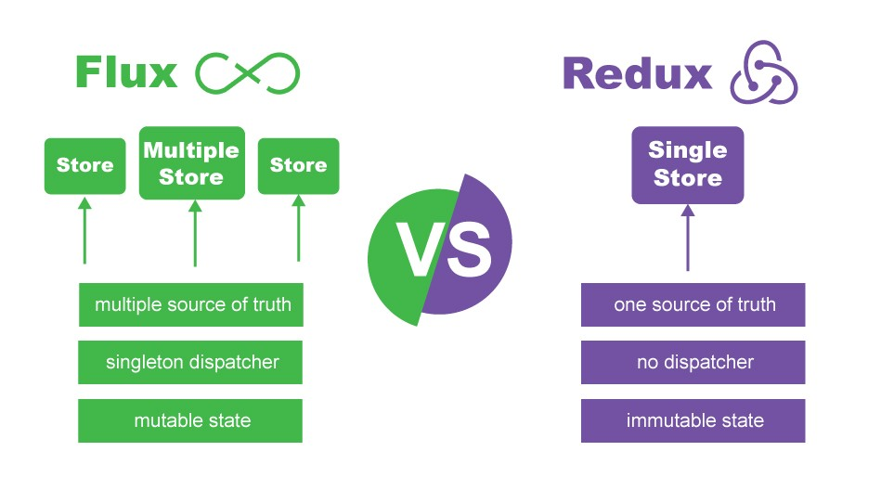
Brief History
Redux was created by Dan Abramov and Andrew Clark in 2015.
Abramov wanted to add functionality to Facebook’s Flux pattern.
Notes:
Redux was created by Dan Abramov in 2015 in collaboration with Andrew Clark who is the author of Flux implementation flummox.
Redux is a derivation/ implementation of Flux design pattern.
We won’t go into details of flux, but we will show you Redux design pattern later on.
/* won’t use this
If you are already familiar with FLUX pattern, then it you will understand Redux easily if not, we are going to explain Redux in more details later in the presentation. You can think of flux as a design specification of state containers , and Redux is a flux implementation/ derivation. The main differences between the two are single store vs multiple stores and mutable state vs immutable state.
*/

Slide 5
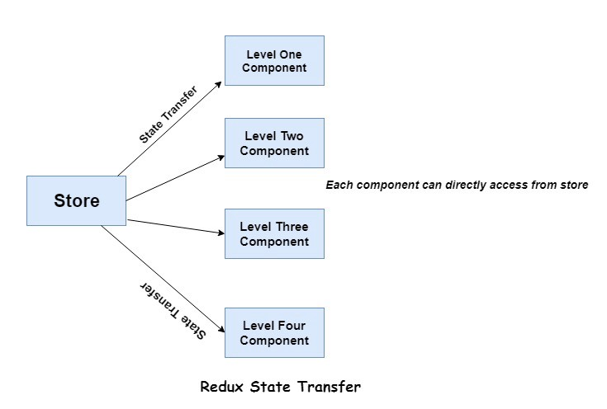
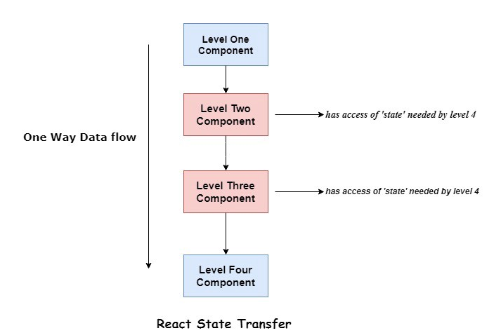
What problem does Redux solve ?
The entire state of an application is stored in one central location.
In libraries like React, stateful components carry their own state.
Each component of an application can have direct access to the state of the application without having to send props down to child components or using callback functions to send data back to a parent.
Notes:
Now that we know a bit of what Redux is, lets look at what is that it actually solves. The main concept behind Redux is that the entire state of an application is stored in one central location.
Since you already know about REACT from last week’s presentation, I will try to explain this using React concept of component. If you remember components are JavaScript class or function that optionally accepts inputs i.e. properties(props) and returns a React element that describes how a section of the UI (User Interface) should appear.
So components carry their own state.
The state could change in response to actions and events. A component's state is meant to be self-contained,
So if you look at the diagram on the left, there are four components with its own state and if level four needs the changes in the state from level two, then it has to be passed on to level three component and then to level four
This will become a problem As your application becomes more complex, the management of state can become tedious.
By using Redux we’re solving this problems by introducing a central data store in our application. The store contains the state of the application and is the source of truth for components. By using the store concept we do not need to synchronize state between components manually. Instead you can fully rely on the Redux store at any time.

Slide 6
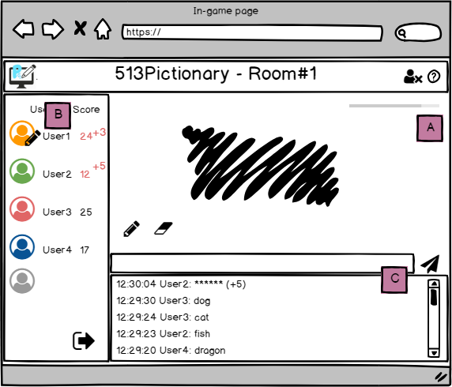
Our Project: 513Pictionary
A multi-user real time pictionary game
MainPage
NavBar
Home Button
Home Title
Logout Button
Help
UserList
...
SketchBoard
...
ChatBox
...
Notes:
Just an brief overview of our project, 513Pictionary. In the game, one player was given the hint and is going to draw based on the key word, and other participants are going to guess the right answer.
We are going to use React for building the user interface and use Redux for state management. As you can see, for this in-game page, we have four child components under the root: the navigation bar, the user list, the sketch board, and the chat box. And each second level component may have its own component tree.
As the game is progressing, React will render the page by component.

Slide 7
Why is using Redux a good idea for our project?
Manage the game state
Where the state should live?
How to share data with sibling components?
Easy for debugging
Redux DevTool
Main Page
B
Store
B
C
C
Notes:
So, why is using Redux a good idea for our project?
First of all, Redux provides a way to manage the app state. In an app where data is shared among components, it might be confusing to actually know where a state should live. Ideally, the data in a component should live in just one component. So sharing data among sibling components becomes difficult.
For instance, in our app, we need to keep track of the user status, including the scores, the connection state, and which user is currently drawing. As indicated by the red rectangles, if a player enters the right answer in the chat box, the corresponding score which he earned will be reflected in the user list.
In plain React, to share data among siblings, a state has to live in the parent component, and a method for updating this state has to be provided by this parent component and passed as props to the sibling components. Which means, in our case, we need to first pass the score change to the main page component, and then call a function from the main page to update the state in the sibling components.
However, in Redux, we can simply dispatch an action, and the store will do everything for you.
The second reason of using Redux is that Redux makes debugging much easier. By logging actions and state, it is easy to understand coding errors, network errors and other bugs that might come up during the production. Later in the demo, we will show how to debug by monitoring the state using Redux DevTool.
Next, we are going to show you the technical details of Redux.

Slide 8
Basic Walkthrough
An introduction to some key concepts of Redux
Notes:
Now we'll be going through the core concepts of Redux

Slide 9
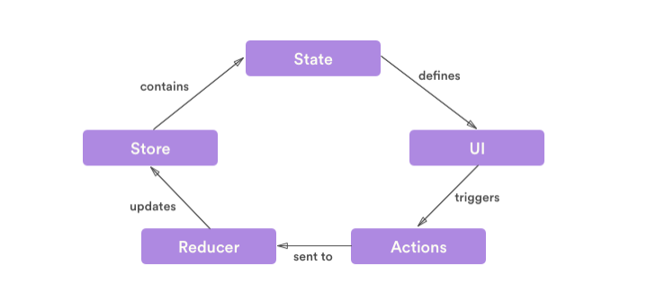
Redux Architecture Overview
Notes:
So this is a general overview of a pure Redux data lifecycle. We’ll be going over these aspects in the next few slides.

Slide 10
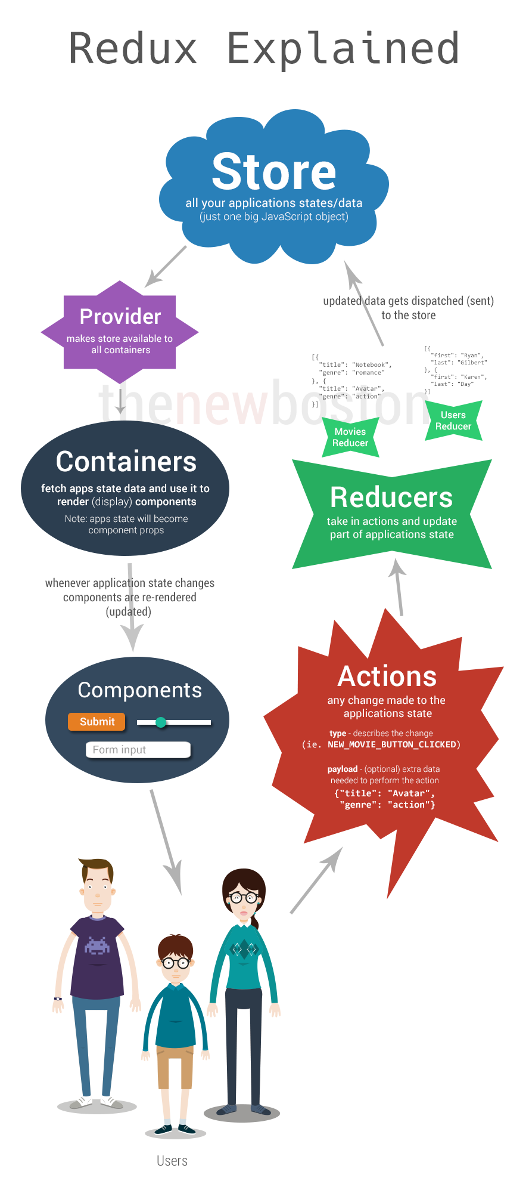
Notes:
Though we won’t cover it, since redux is often used with react in the industry, it’s also worth showing the extra stuff that you need to be aware of if you’re planning to develop in react redux environment like Providers and Containers.

Slide 11
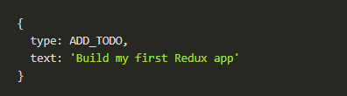
Action
Object that describes the application state change
It doesn’t change the state, but describes what changed.
Triggered by user input.
Sent from application to the store using store.dispatch(action).
Contains the following structure:
type - required property that indicates the type of action being performed .
payload - optional properties that can contain bits of data or a state.
Any actions occurred are sent to all reducers.
Notes:
Actions are objects that describes the application state change.
Like what was previously stated, an application has a state. When the state changes, we need a way to communicate this change so it could be properly handled.
Note that actions do not change the state, it only describes what changed.
It’s triggered by user input such as clicking a button or submitting a form which is then sent to the redux store by calling the store.dispatch() function with the action parameter implemented within the component.
There isn’t really a strict structure for an action object except for one requirement - the type property, which simply indicates the type of action being performed.
The payload can be named anything, for example ADD_TODO, FOO_BAR or PAVOL - since it will be all handled by the reducers that we have to define.

Slide 12
Reducer
Function that specify how the application’s state changes
Changes to state are applied based on the action it was given, a new state is returned.
An application can have a multitude of actions, which is usually handled by a switch statement
Reducer can be split into separate functions where “smaller” reducers are given just a slice of the global state to manage.
This is called Reducer Composition - it is the fundamental pattern of building Redux apps.
Store can only accept one root reducer, use combineReducers() to combine all reducers results.
Notes:
Reducers are essentially functions that specify how the application’s state changes.
How it works is that the type of changes to the state are applied based on the action it was given, then a new state is returned.
What is means is that when the reducer is called, the current state of the application and the action is passed onto the function.
Additionally, it will make a copy of the current state and apply the action to the copy rather than to mutate the previous state
How the state changes depends on the action that was passed into the reducer.
This modified state the reducer returns is now the new state of the application.
Normally, the reducer handles many different action types through a switch-case statement, and to be on the safe side of things, we can return the original state as a default
When the application grows too big, or the reducer becomes too verbose, we can simply split the reducer into separate function and files and give them the slice of global state they need to function.
This is called reducer composition, and it’s the fundamental pattern of building Redux apps!
Because the state only takes in a single, root reducer, we need to combine all these composition into a single reducer by using the combineReducers() function.
What it does is simply calls all the reducers that has the slices of the state and combines their results into a single object again.

Slide 13
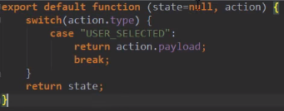
Reducer
Function that specify how the application’s state changes

Slide 14

Store
Holds all application’s states - one REALLY big javascript object.
Just an object with a few methods on it.
store.getState() - allows state access
store.dispatch(action) - dispatches an action to the reducer; only way to change the state
store.subscribe(listener) - listens to dispatched actions
store.replaceReducer(nextReducer) - replaces the current root reducer
Notes:
So the store is this one giant javascript object that contains ALL the application’s states which is its main purpose.
In addition, the redux store has the following responsibilities.
In order to allow the application to access the state, the redux store gives us the getState() function that returns the current state of the application
If we want to update the state, we can call the dispatch() function, passing the action object in the parameter. This is the redux store’s way of calling the reducer function.
The subscribe() function simply allows us to run a listener function every time any action is dispatched. To unsubscribe, simply call the function that it returns.
And finally, the replaceReducer() function just replaces the root reducer the store is currently using.
Given our example here, to create a store, we simply import createStore function from redux, define a root reducer, in this case is called allReducers, then set a constant that will call the createStore function with the allReducers as the reducer parameter.

Slide 15
Data flow
Strict unidirectional data flow
Data lifecycle steps:
Call store.dispatch(action) inside the application.
Redux store passes the state and action to the root reducer.
Root reducer updates the state tree (or combine output of multiple reducers to a single state tree).
Redux store saves the complete state tree returned by the root reducer.
Notes:
Putting everything together, Redux has a strict unidirectional data flow, which means that all data in the application follows the same lifecycle pattern.
The data lifecycle consists of 4 steps:
First, when a user interacts with the application, such as clicking a button or sending a form, the application sends a dispatch to the store that contains the action.
The store then receives and passes the action, along with the state, to the root reducer, which will update the state based on the action it was given.
Lastly, the store saves the state tree returned by the reducer, and this is now the new state of the application.

Slide 16
Demo
Set up a Redux Project and debug with Redux Dev Tool

Slide 17
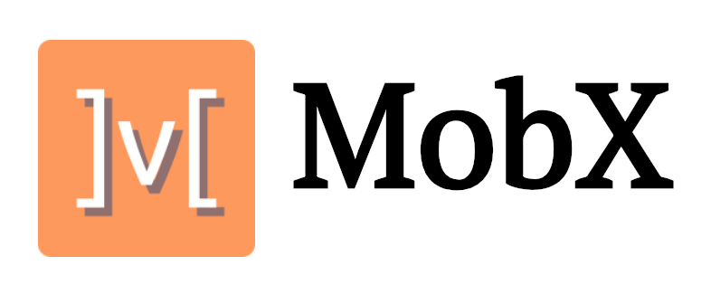

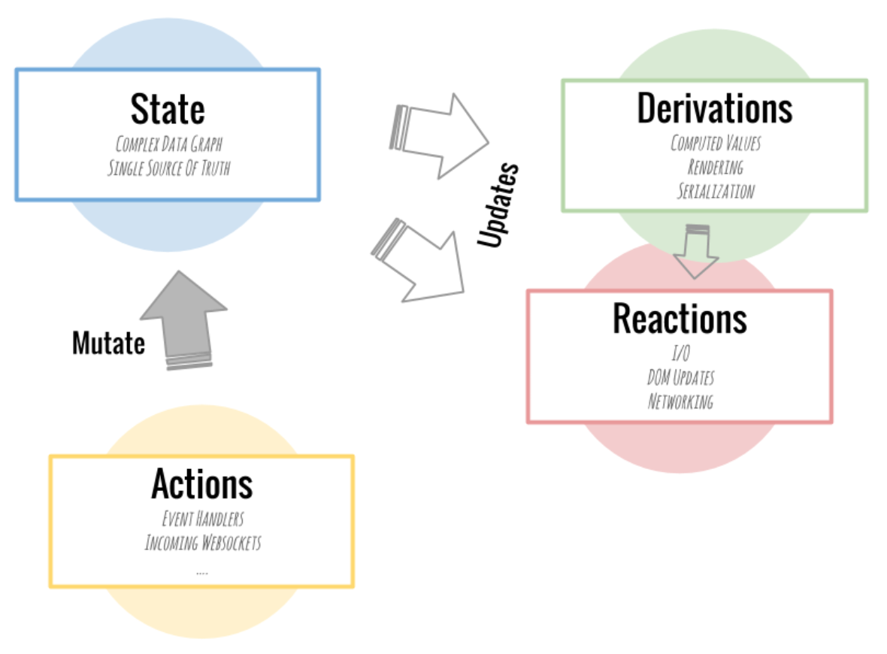
Competing Technologies
Notes:
MobX makes state management simple again by addressing the root issue: it makes it impossible to produce an inconsistent state.
Different from Redux: MobX is just a library to solve a technical problem and not an architecture or even state container in itself.
No need for adding listeners for the data changes
Object Oriented concepts
Easy to document and communicate
Rapid development
Lifecycle hook called componentWillReact()

Slide 18
Single store in which all the states are stored.
Uses a normal Javascript object to store the data.
Uses immutable states. That means the states are read-only, and cannot be directly overwritten.
Follows functional programming paradigm.
Higher learning curve.
Typically has more than one store.
Uses an observable to store the data.
States are mutable and can be overwritten.
Follows Object Oriented programming paradigm
Lower learning curve
Notes:
Incomparing Redux with MobX,
Redux uses single store while MobX typically has more than one store. As a result in MobX you can logically separate stores. Redux keeps data usually normalised. In MobX, you can keep a denormalised data.
Redux uses a normal Javascript object to store the data. On the other hand MobX uses an observable to store the data.
That means you can listen to an observable and automatically track changes that occur to the data. In redux all the updates have to be tracked manually.
Redux uses immutable states. That means the states are read-only, and you cannot directly overwrite them. In Redux the previous state is replaced by a new state. As a result Redux is pure, or it uses pure functions.
This can come in really handy when you have to revert back to a previous state. Eg — An undo action.
In MobX states can be overwritten. You can simply update a state with the new values. As a result MobX can be termed as impure.
Redux follows a functional programming paradigm while Mobx uses OOP. As a result MobX is much easier to learn and has a steady learning curve. since most of the traditional Javascript developers are familiar with OOP. There is lot of abstraction in MobX which makes it easier too.
Mobs is usually the choice for application small and simple. Also MobX can help app faster due to lower learning curve.
For large complex and scalable app, redux is the choice.

Slide 19
Heavier in package size
More verbose
Suitable for complex scalable applications
Small lightweight state management library
77 % smaller in package size
Simpler to use verbose wise. With unstated you just have to deal with a container and a component which subscribe to it.
Suitable for smaller apps
Notes:
Unstated is a smaller lightweight library compared to Redux. Simpler to use comparatively since
What is achieved with many different files on Redux can fit in a single file on unstated if you want. Also it is suitable for smaller apps but redux is usually capable of handling complex scalable application.

Slide 20
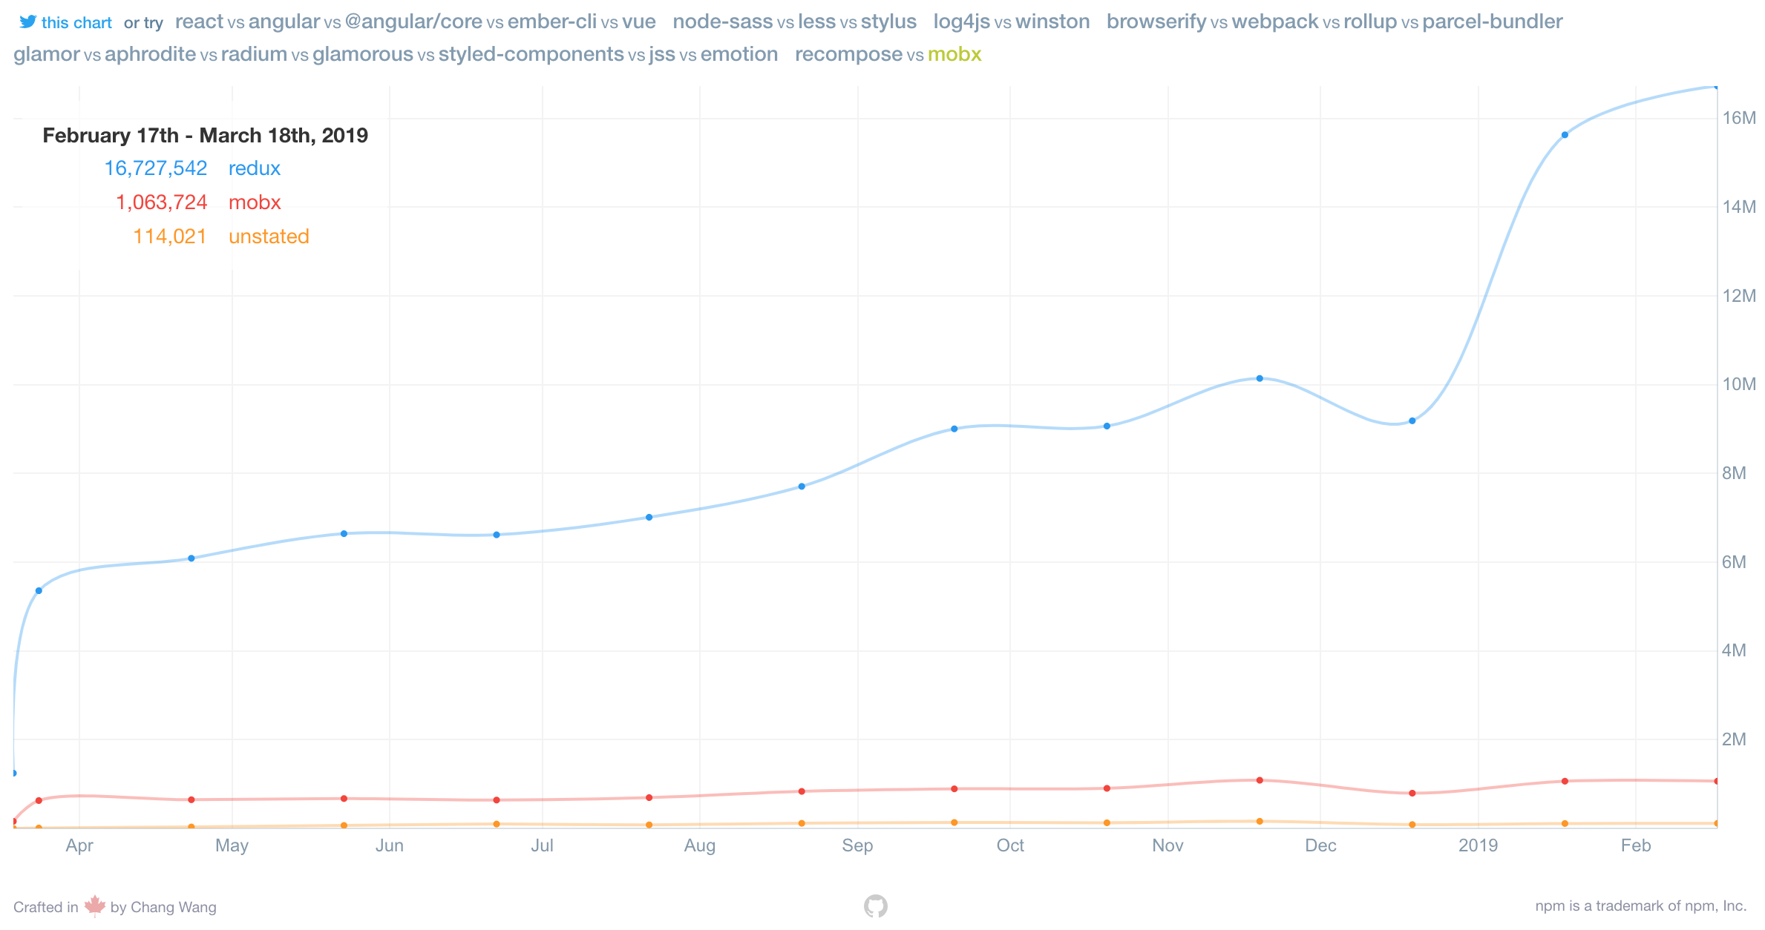
Redux Alternatives
MobX and Unstated

Slide 21


Slide 22
Multiple Choice Question 1
How can you send the action FOO to the Redux store?
dispatch(store, FOO)
store.dispatch(FOO)
store.send(FOO)
send(store, FOO)

Slide 23
Multiple Choice Question 2
2. What are the main concepts in Redux ?
Action, Provider, HTTP request
Action, Reducer, Store, State
Action, State, Producer
Action, Reducer, Component, Store, State
Notes:
An action is dispatched when a user interacts with the application.
The root reducer function is called with the current state and the dispatched action. The root reducer may divide the task among smaller reducer functions, which ultimately returns a new state.
The store notifies the view by executing their callback functions.
The view can retrieve updated state and re-render again.

Slide 24
Multiple Choice Question 3
2. Redux is a derivation from which design pattern?
MVC
Adapter
Flux
Observer

Slide 25
QUESTIONS/COMMENTS

Slide 26
References
https://www.fullstackreact.com/articles/redux-with-mark-erikson/
https://en.wikipedia.org/wiki/Redux_(JavaScript_library)
https://redux.js.org/introduction/getting-started
https://medium.com/@dakota.lillie/flux-vs-redux-a-comparison-bbd5000d5111
https://www.valentinog.com/blog/redux/
https://hackernoon.com/why-redux-cbfc6fc5f788
https://codeburst.io/mobx-vs-redux-with-react-a-noobs-comparison-and-questions-382ba340be09

